Slide 1
Educating Students with Disabilities in the Least Restrictive Environment
June 6, 2019
Pacific Blvd School

Slide 2
Outcomes
Increase Knowledge of Special Education Legal Requirements and the principle of Least Restrictive Environment
Review Parent’s Procedural Rights and Safeguards regarding Special Education

Slide 3
Legal Mandates
Federal Law
  Individuals with Disabilities Education Act (IDEA) 2004
  Code of Federal Regulations (CFR)
State Law
  California Education Code (EC)

Slide 4
IDEA Requirements
The IDEA mandates that the placement for each student with a disability be only as restrictive as the student’s individual needs require.
The basic regulatory requirement is that students should only be segregated from the regular education classroom if they cannot be educated satisfactorily in regular classes with the use of supplementary aids and services.
  This requirement is set out in the IDEA regulations at 34 CFR Sec. 300.500.

Slide 5
IDEA’s Preference for Educating Students with Age-Appropriate, Non-Disabled Peers
The regulations are driven by the IDEA’s strong preference that to the maximum extent appropriate students are to be educated with age-appropriate, nondisabled peers, but they also provide that the regular education setting is not appropriate 100% of the time or in 100% of the cases.

Slide 6
Least Restrictive Environment (LRE)
Specifically the law states:
  Students must be educated in the general curriculum and/or
  Participate in activities with other students who are not disabled
  To the maximum extent appropriate

Slide 7
Least Restrictive Environment
(LRE)
Generally, the LRE is the most appropriate placement or setting for a child with a disability that most closely approximates where the child, if not disabled, would be educated.
Notes:
Generally, the LRE is the most appropriate placement for a child with a disability that most closely approximates where the child, if not disabled, would be educated.
The least restrictive possible environment includes fulltime participation in regular classes and full participation in school activities with non-disabled students. Other placements are considered more restrictive to the degree that a student is removed from regular classes and full participation in non-curricular and extracurricular activities with students who are not disabled.

Slide 8
The Least Restrictive Possible Environment (LRE)
The least restrictive possible environment includes:
  Fulltime participation in regular classes and
  Full participation in school activities with non-disabled students.

Slide 9
Moving to More Restrictive Environments
Other placements or settings are considered more restrictive to the degree that a student is removed from regular classes and full participation in non-curricular and extracurricular activities with students who are not disabled.

Slide 10
Continuum of Available Placement Options
The regulations also mandate that the public agency offer a wide range of placement options, known as the continuum of alternative placements, to ensure that each student is educated in what is determined to be the least restrictive environment that is appropriate for that individual.

Slide 11
Continuum of Placement Options from Less to More Restrictive includes:
General education schools
  General education classroom with accommodations and modifications
  General education classroom with supplementary aids and supports
  General education classroom with related services
  General education classroom with resource specialist services
  General education classroom and special day program
Special day program
  Special schools or centers
  Special day program
Nonpublic schools
  Dual enrollment (public and nonpublic schools)
  Nonpublic school or center
Home or hospital
  Instruction in the home or hospital
Residential
  State special school*
  Nonpublic School or Center

Slide 12
Role of the IEP Team in the LRE Determination
The IDEA provides that the extent to which an individual student with disabilities participates in the regular education setting with the use of supplementary aids and services must be determined on a case-by-case basis by the individualized education program (IEP) team.

Slide 13
Required Members of the IEP Team
Child's parent or guardian, and/or representative;
A school administrator;
A special education teacher or a special education provider when appropriate;
A general education teacher if the child is or may be participating in general education;
Other persons, such as the child, or whom the parent or the school wish to invite; and
A person knowledgeable about the assessment procedures used to assess the child, familiar with the results of the assessment, and qualified to interpret the instructional implications of the results. This may be one of the persons described above.
There are circumstances where members of the IEP team can be excused from attending, with parent’s written approval.

Slide 14
IEP Team Responsibility
Identify the unique educational needs of each eligible student and determine the possible range of aids and supports that might allow the student to be educated satisfactorily in the regular educational environment before a more restrictive placement is considered.

Slide 15
Continued LRE Mandates with Respect to Making Placement Decision
Special classes, separate schooling, or other removal from the regular classroom occurs only when the nature or the severity of the disability is such that education in the regular class cannot be satisfactorily achieved with appropriate aids and supports.
Unless the student’s IEP requires some other kind of arrangement, the student attends the same school he or she would attend if not eligible for special education services.

Slide 16
Continued LRE Mandates with Respect to Making Placement Decision
3. Students with disabilities must be afforded the opportunity to participate in nonacademic and extracurricular services and activities along with their peers in regular education
4. When there is a reasonable likelihood that a student with a disability can be educated in the regular classroom with the use of supplementary aids and supports, then that placement should be tried.

Slide 17
Parents’ Rights and Procedural Safeguards

Slide 18
A Parent’s Guide to Special Education Services
Distributed to Parents at the following times:
  Upon initial referral for special education or initial request for an evaluation;
  Each time the parent is given an assessment plan to evaluate their child;
  Upon initial filing of a State complaint, request for mediation only, or request for a due process hearing in a school year;

Slide 19
A Parent’s Guide to Special Education Services Continued
Distributed to Parents at the following times:
  Whenever a decision is made to take disciplinary action that constitutes a change in placement;
  Whenever a parent revokes consent for continued provision of special education and related services; and
  Whenever a parent requests a copy.

Slide 20
Parents’ IEP Process Rights
Parents must be part of IEP team that makes educational decisions regarding child’s educational program
District must make reasonable efforts to ensure parents understand the offer of free appropriate public education (FAPE).

Slide 21
Right to Prior Written Notice
Before Proposing or Refusing to Assess
Before Proposing or Refusing to Change
  Identification
  Educational placement
  Special education services

Slide 22
Right to Information in Primary Language
Written correspondences
Request for Oral interpretation at IEP Meeting
Request for Written Translation of IEP documents

Slide 23
Right to Consent
Initial Assessment
Initial Provision of Special Education Services
Release of Educational Records

Slide 24
Right to Request an Initial Assessment
Parents must be provided a written response within 15 days of the school’s receipt of the request.
School staff should assist the parent with putting any verbal requests in writing.

Slide 25
Right to Access Educational Records
Request May Be Oral or Written
School to assist Parent put request in writing
Within 5 Business Days of Request Parents May
  Inspect and review records
  Request explanation/interpretation of records
  Be given copies of records

Slide 26
Age of Majority – 18 years
Parents make decisions about the student’s educational program until age of 18.
When the student turns 18, educational rights transfer to the student.
Parents and students must be informed of this transfer of rights.
  This is documented on the IEP at least one year before the student turns 18.

Slide 27
Right to Procedural Safeguards to Resolve Disagreements
Assessment
Eligibility
Instructional Setting
Services

Slide 28
Right to File Complaint
Local Complaint
  Complaint Response Unit (CRU)
  Uniform Complaint Procedures (UCP)
State Complaint
  California Department of Education (CDE)
Local/State Complaint Procedures
  Investigation
  Written decision
  Appeal process

Slide 29
Right to Revoke Consent for Services
Revoke Continued Provision of All
  Special education services
  Related services
Request Revocation in Writing
District Provides Prior Written Notice
  Within 5 business days of request
District Ceases Services
  15 calendar days from date on prior written notice form

Slide 30
Parent Preparation for an IEP Team Meeting

Slide 31
Before the IEP Team Meeting
Review “A Parent’s Guide to Special Education Services (Including Procedural Rights and Safeguards)”
Review the “ITP and You” if you have a child 14 years or older
The IEP and You, p. 2

Slide 32
Before the IEP Team Meeting
Write down questions you want to ask, thoughts, and/or concerns
Review and return the “Notification to Participate in an IEP Meeting”
The IEP and You, p. 2

Slide 33
Before the IEP Team Meeting
Look at recent information about your child’s progress
Review your child’s current IEP
Go over important information that you want to share at the IEP meeting
The IEP and You, p. 2

Slide 34
Before the IEP Team Meeting
Give copies to the school of any recent private evaluation reports you want to share with the IEP team
Talk to your child
Visit your child’s school and meet with teachers to talk about your child’s progress
The IEP and You, p. 2

Slide 35
Strategies for a Productive Meeting
Stay student-centered
Focus on student’s needs
Be an active listener
Ask questions for clarification

Slide 36
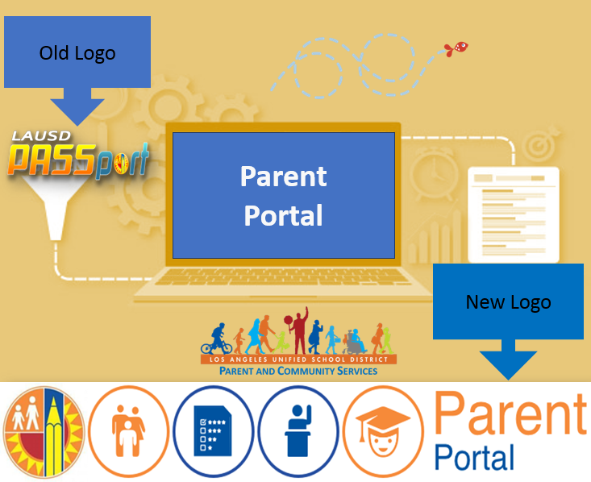
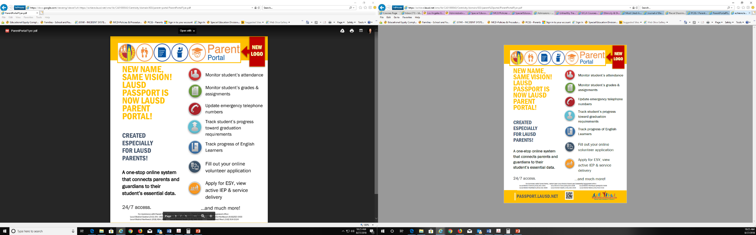

Resources for Parents
Parent Portal (formally PASSport)

Slide 37

Thank you for your attention today !

